Slide 1
A Conversation With The
City of Jacksonville
Update of June 6, 2018 & October 21, 2019 (JCC)
February 24, 2020
By
Hartman Consultants, LLC.
Thomas A. Cloud, Esq.
HC #20007.00

Slide 2
Gerald C. Hartman, PE., BCEE, ASA
Duke University B.S. ’75, MS ’76
600 Utility Sale or Appraisal Projects over 42 Years
36 States
Expert Witness at 9 State PSC’s
Expert Witness in some 200 Court Cases
Duke Energy/FPC – Citrus County
Dover Delaware
Vero Beach/FP&L
Bushnell/SECO
Grand Tower Energy Center
Bayou Cove/NRG
Many Others
Numerous Water & Wastewater (approximately 550 of 600)

Slide 3
Thomas A. Cloud, Esq. - Gray Robinson, P.A.
Wake Forest University B.A. ’76, FSU Law ’79
Board Certified City, County & Local Government Law By Florida Bar
General Counsel, Utilities Commission, City of New Smyrna Beach
Represented Over 80 Cities and 20 Counties in Florida
Over 100 Utility Sales
Worked on Three of the Four Florida Municipal Electric System Purchases in the last century (Winter Park, Bushnell & Vero Beach)

Slide 4
CITY REQUESTS
Update the JCC Presentations
Potential Future Activities

Slide 5
JEA Initial Criteria & Considerations
Criteria
Achieving JEA’s Goals
Experience and Customer Commitment
Economic Development and Benefits to Jacksonville
Employee, Retention and Benefits
Plans for Innovative Services and Investments
Considerations
Community Stewardship
Financial Stability
Environmental, Social and Governance Commitments

Slide 6
Where We Are
Initial Step on a Sale – Get Interested and Qualified Bidders (Successfully Done) Other Sale Work Done – Now Sale Activities Halted
Other Improvements – Not Adequately Performed To Date – Now Is The Time To Do It
Basis for Decisions:
Appraised (USPAP) Value – Not Done
(PFM is an Investment Banking/Financial Advisor – Not an Accredited Appraisal Firm)
Thoroughly Examine COJ Ownership Activities
Public Should Be Informed and Listened To

Slide 7
JEA Scenarios (October 11, 2019)
Scenario #1: Status Quo Plan – Not a Professionally Managed Scenario – Every Utility Adapts to Change
Scenario #2: Traditional Utility Response Plan – Actively Manage Utility Considering Opportunities Available
Scenario #3: Community Ownership Plan (Similar to Utility Cooperative Style) – Not Really An Option
Scenario #4: Initial Public Offering (IPO) Plan – Not Really An Option
Scenario #5: ITN Plan (Sale) – This Is An Option
Scenario #1 & #2 are really just one scenario – that of optimization, professionally address challenges, adapt to change, etc.
Scenario #3 & #4 are not really an option
Scenario #5 is the other scenario. Many utilities compare the results from Scenarios #1 & #2 with a sale

Slide 8
Scenario #1 – Status Quo Plan
  JEA said this was complete. Nonetheless, very little has been provided except a few summary tables with assumptions that have not been verified and certain high-level summaries
  Typically, the Status Quo Plan incorporates the current management analyses of:
  Planning possibilities and range of forecasts – Gives future definition to anticipated challenges
  Financial Optimizations – Capacity Sales, Refunding Options, Numerous Existing Program
  Operational Optimizations – From in-house outsourcing to contract operations
  Capital Program Value Engineering – What is most effective
  Management Proposals –Alter Current Structure, City Council Participation, Others
  Opportunities and Impacts – Identify & Analyze
  Enhancements – From sources of revenue enhancement, to customer equity
  Review of current practices which can be improved – A collaborative look in-house
  Typically a report or series of reports are complied and discussed with public. (Such documents have not been found to date)

Slide 9
Scenario #2 – Traditional Utility Response
  JEA said this was complete. Comparing the current JEA conclusions “a combination of cost cuts, head-count reduction, a deferred of capital investment in the community and rate increases to customers.” It does seem dire. It also seems to lack what other appropriate utilities – like OUC, Orlando, Lakeland, Orange County did as an example
  From the conceptual JEA work, a 12% water and wastewater rate increase over 18 years is less than inflation and is actually quite good
  Few and only generalized public documents have been provided
  There are several innovative programs on-going in Florida

Slide 10
Scenario #3 – Community Ownership
  This scenario was not completed by JEA
  There are Utility Cooperatives, Charitable Trusts, Not-for-Profit Entity Options (63-20 IRS), and Dependent or Independent Authorities
  With good JEA Management, typically these entities should be less competitive than JEA based on national experiences
  Downsides included start-up costs, complexities, governance, higher interest costs, less surety

Slide 11
Scenario #4 – Initial Public Offering (IPO)
  Again this scenario has not finished JEA evaluation
  It is a scenario that we have not seen implemented successfully by a City
  The City is not a start-up private business that typically would go through this process for capitalization
  Failures are common. Public Utility failure is not an option with a monopoly providing essential public services

Slide 12
Scenario #5 – ITN – Sale - Halted
  Basis work has not been done (Appraisal, etc.)
  Three separate power, three separate water, and four complete (power & water) entities provided interest. The anonymous entity is just that at this time
  At this juncture, the vast majority of the work is still ahead
  In many cases, large private company regionalization and expertise have benefited cities and counties
  The Fair Market Value Legislation – out of committee – would need to pass the Florida Legislature to provide for a reasonable sale

Slide 13
Summary of Bidders
Electric
Duke Energy
FPL – Next Era Energy
Emera – TECO & Peoples
Water
American Water
Suez
Duke Energy
Investors
Macquarie Infrastructure & Real Assets, Inc.
American Public Infrastructure, LLC
IFM Investors Pty, Ltd
Joint Venture
JEA Public Power Partners (Emera, Barnhart Capital Partners and Suez)
Anonymous
One Entity

Slide 14
Management Decisions Review
Asset Disposition Consideration now halted by JEA was an appropriate management activity, yet it is premature without other optimization activities
City Council is now investigating additional information and considering public and professional comments
JEA does not have either a Water & Wastewater or an Electric rate base. FPSC has not determined or ordered the JEA rate base. (Premature activities). Such information is needed for full consideration. (Legislation for FMW is out of two (2) committees as of 2/17/2020)
There are incomplete analyses of viability which are major factors to a successful, effective, and sustainable utility

Slide 15
Management Decisions Review (cont.)
City Council to consider a consultant to assist management such as a Mr. Fred Haddad (previous OUC) or another on a temporary basis
Implement a JEA management rebuilding program
City Council and Mayor to select a new JEA BOD equally
City Council then voters clearly to have asset disposition powers
JEA BOD and management to do – research and recommendations to operations, finance, engineering, budgeting, customer service, etc.

Slide 16
Conceptual Value Consulting Summary
($ x Billion) ⁽¹⁾
Description | Consulting Approx. Value Potential | Estimated Net Proceeds | Estimated Time Req. | Comments
Electric System | $4.8 +/- | $1.0 +/- | 1.5 yrs. | Secure long-term lower rates (FP&L) or others; get ad valorem taxes, get franchise fees, get fund balances, get utility tax, transfer restricted funds and debt service reserve funds.
Generation Only Not Bid Separately | N/A | Small | N/A | Not Bid Separately.
Electric T&D Not Bid | N/A | N/A | N/A | Not Bid Separately.
Chilled Water | Small | Small | N/A | Minor transaction, little benefit, better to be packaged with electric.
Water and Wastewater | $3.3 +/- | $1.0 +/- | 2 yrs. | Loss of utility rate control to FPSC or to NFP.
All Utilities | $8.1 +/- | $2.0 - 3.0 +/- | 2+ yrs. | City gets franchise fees, fund balances, utility tax, ad valorem tax, transfer of restricted funds, transfer of debt service reserve, etc. funds.
⁽¹⁾ Rounded Very Preliminary/Rough Estimates

Slide 17
Fully and Publicly Decide on Goals & Objectives (Suggestions)
- Proceeds for City General Fund CIP – (How much needed for what?)
- Stable or Lower Customer Rates – (Evaluate Each Option)
- Assumption of Existing Customer Contracts – (Honor Agreements)
- Economic Development – (Development Programs, Local Synergies,
Responsible Service)
- Good Customer Service – (Existing and Examples with large systems)
- Reliable Operations – (Proven abilities)
- Excellent Quality – (Track Record and Effective Actions)
- Prudent/Innovation – (Correct certain management decisions, accomplish what can be done (examples in Florida))

Slide 18
Define Sources & Uses
What projects are “high priority”
How much do they cost?
How much can the City fund from other sources?
How much is the need (i.e. $1 Billion, $3 Billion, $5 Billion?)
Have you performed “Value Engineering”?
Consider “simplified” future operations and improved effectiveness?

Slide 19
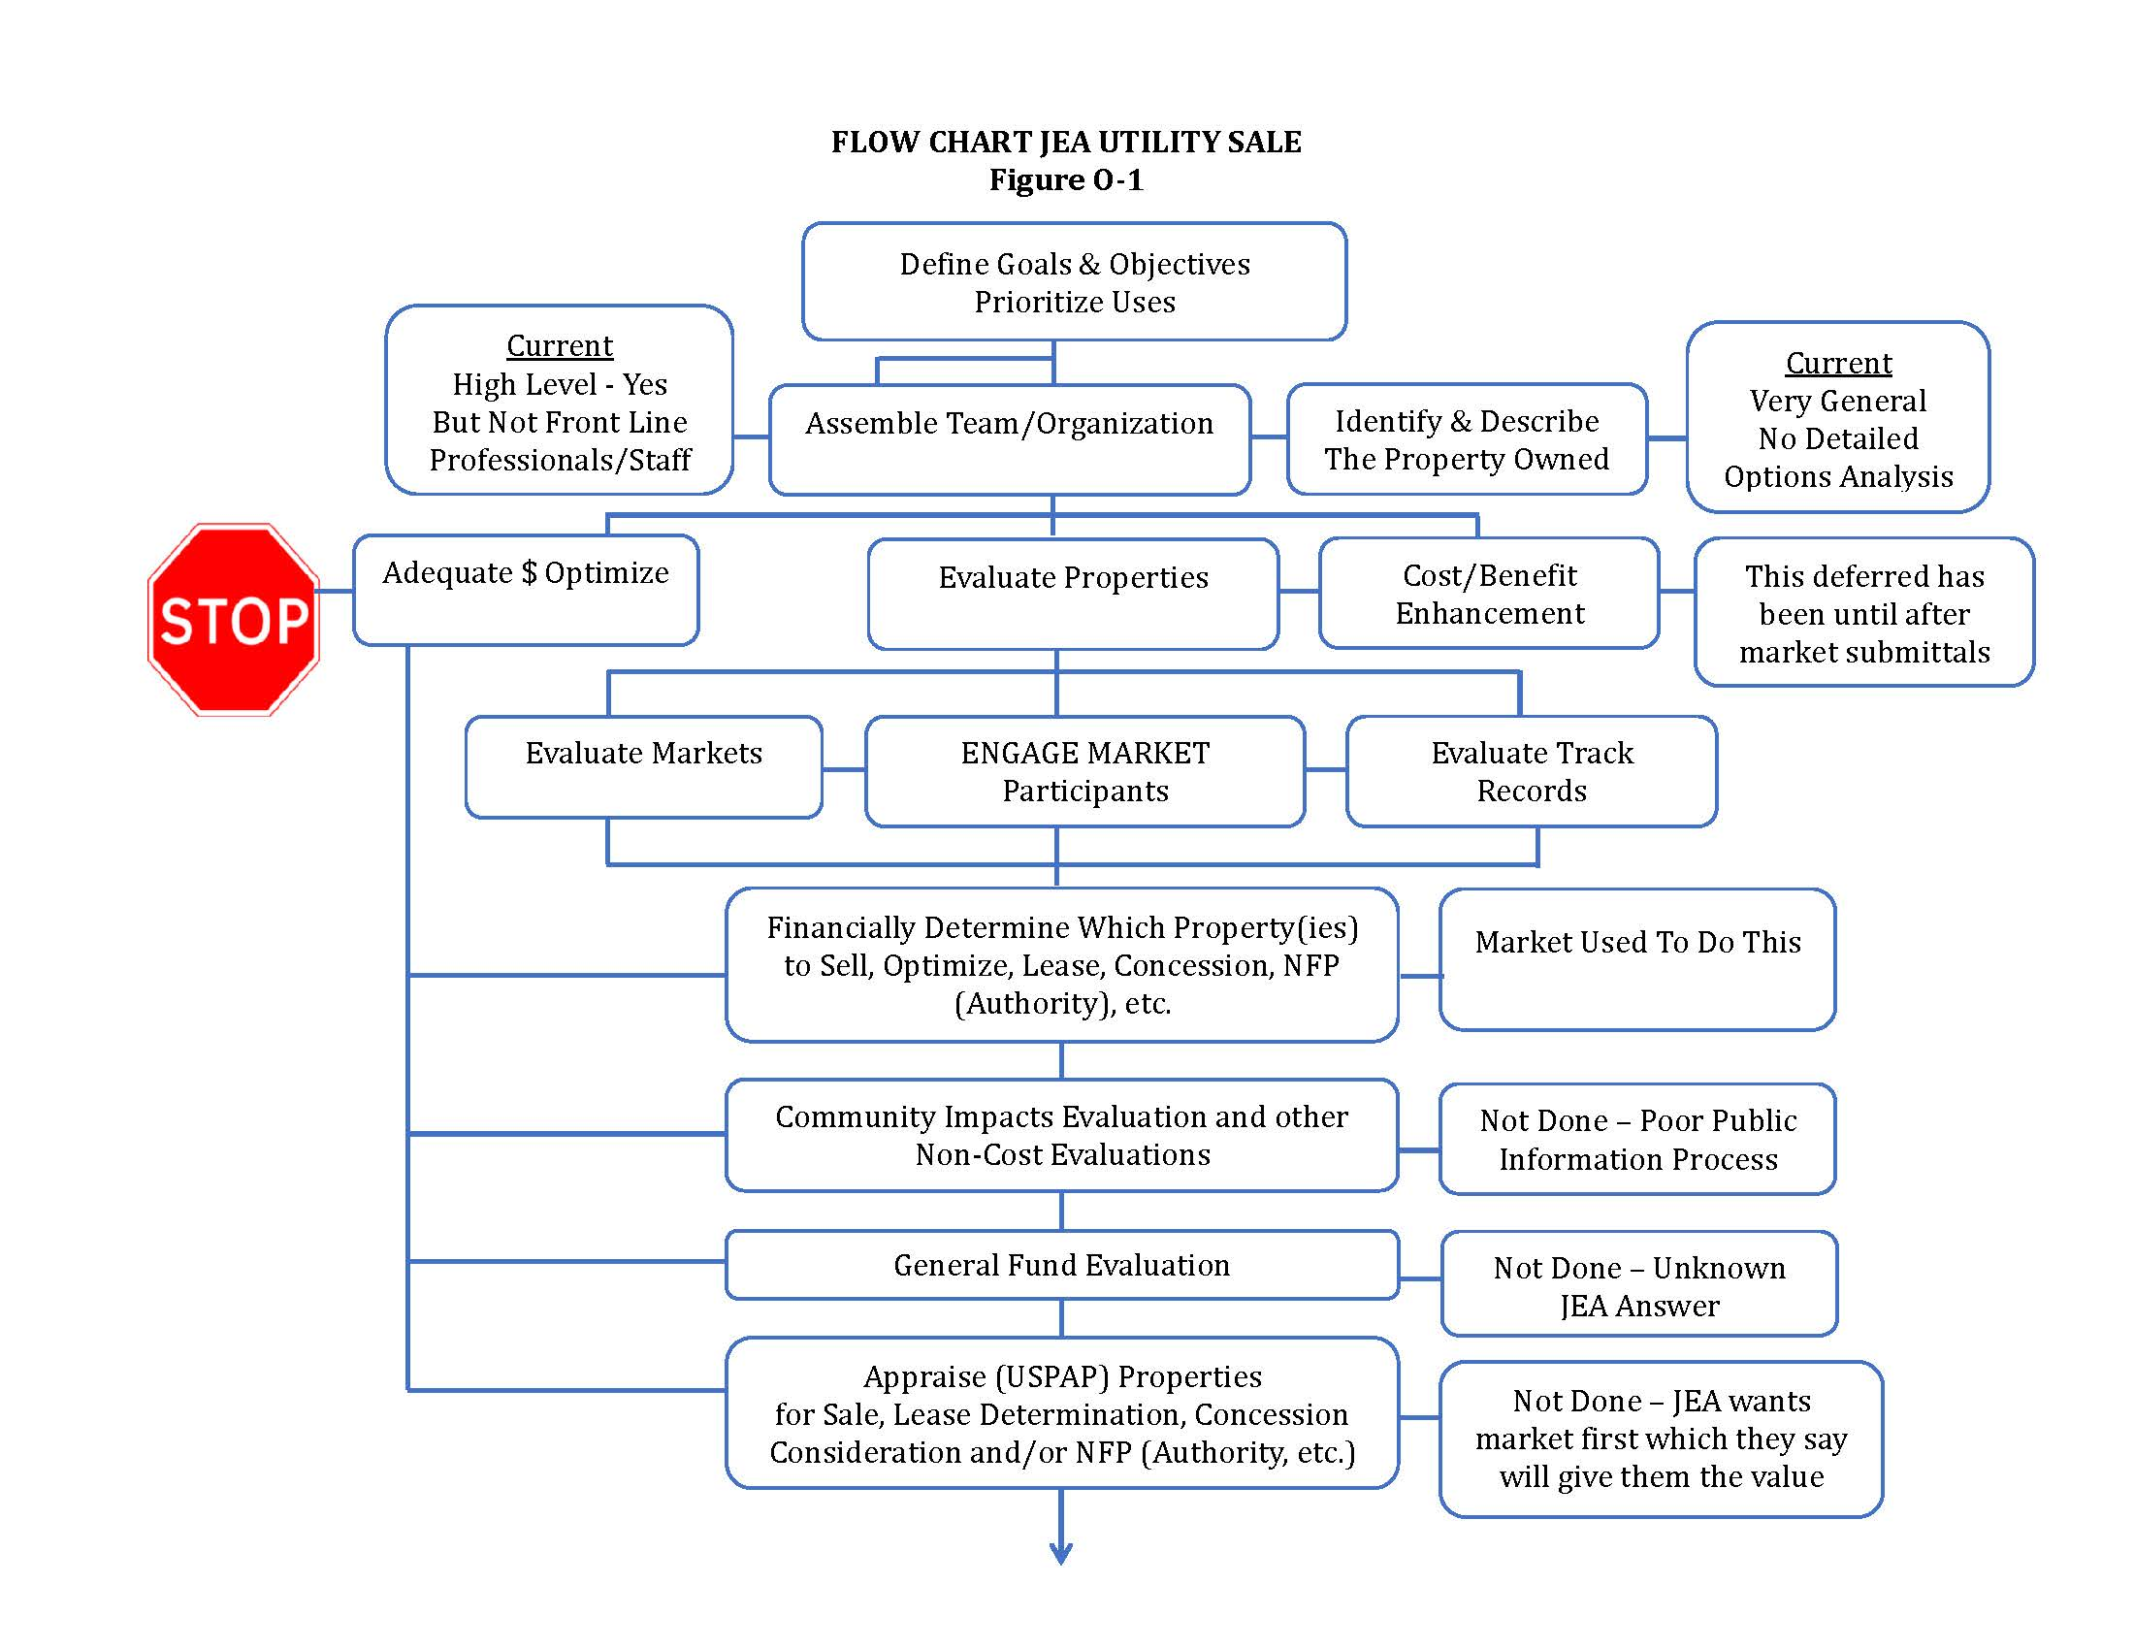
Flow Chart

Slide 20
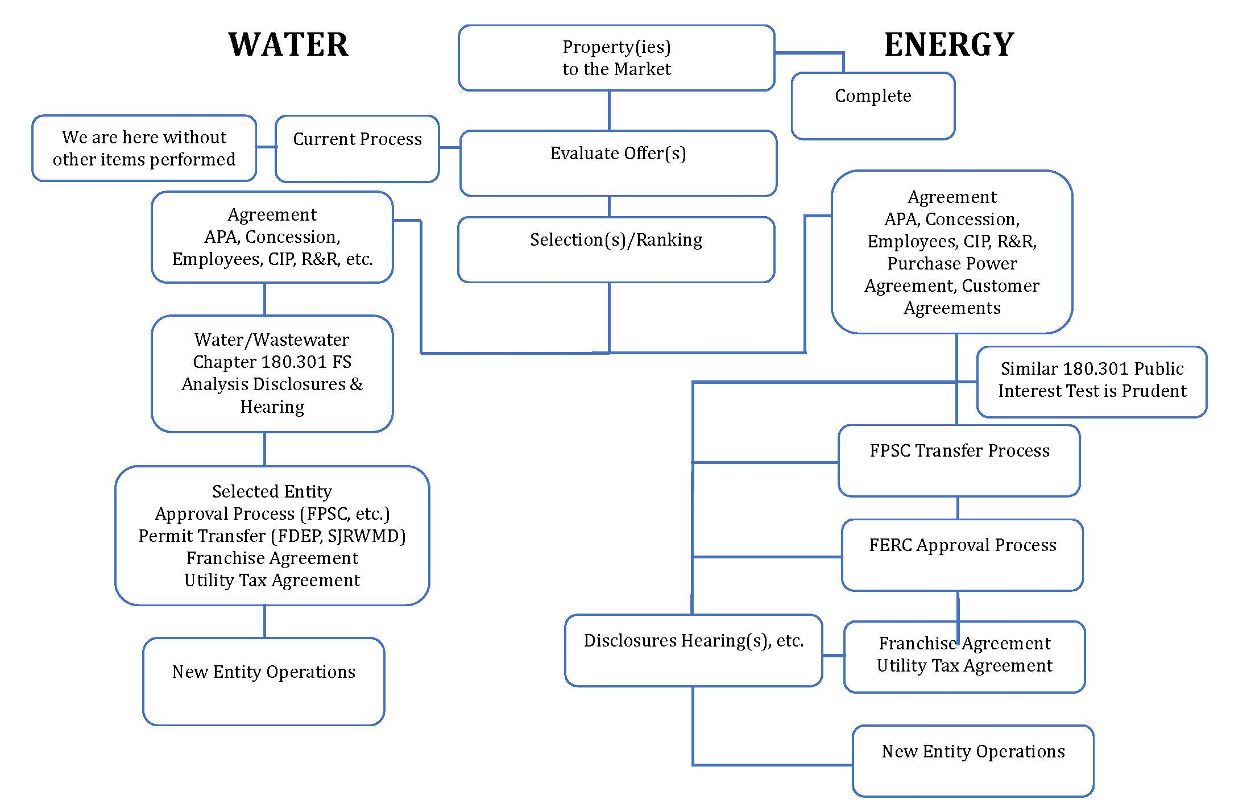
Flow Chart (cont.)

Slide 21
Need To Document, Describe, And Modify Property For Best Operations
Legal Description
Engineering Description
Insurance (Due Diligence) Report(s)
Low Cost Optimizations
Strategic Investments

Slide 22
Items Not Done So Far or Are “Not Available”
Analyze Comparative Sales of similar properties individually and combined
Discuss with Market Participants enhancements and optimizations
Get their insights and comments
Engage
Provide Data
Track Records – Investigate communities following sales
Obtain their current “Key Factors”

Slide 23
Items You May Choose To Do
Appraise the Property Offered for Sale (USPAP Compliant Utility Appraisal) PFM report was not an appraisal
Proper Public Property Due Diligence
Example Vero Beach – Only with an appraisal could the FP&L offer increase from less than $100 million to almost $200 million (Appraisal about $200 million in value) – Water and Wastewater Appraisal value was also much greater than offers and therefore not sold
Develop and implement an optimization program, detailed with front-line staff, etc. includes operations, financial (various activities), effective capital investment and engineering (modernization, efficiency, etc.)

Slide 24
Summary
Consideration of (a) utility enterprise improvement versus (b) asset disposition is a prudent management activity
Several entities included in the nine (9) responses to the ITN are well known and capable utility providers
The activities upto 10/7/2019 have not included appropriate public and City Council information, review and/or responses due to the “cone of silence” used by historic JEA management. This situation can be corrected
Important process activities were either not done, deferred, or not thoroughly performed by previous JEA management
Allow internal plans to meet challenges to mature and be more thoroughly done such that JEA can reach its potential
It is difficult to compare options without the above being done or to negotiate without a USPAP Compliant Appraisal. Acceptance of the “best deal” offered may not be prudent or appropriate without a frame of reference

Slide 25
QUESTIONS

